Slide 2
WHAT WE DID, HOW WE DID IT, WHAT WE LEARNED
And How You Can, Too

Slide 3
What We Did
Universal preschool with fair wages for workers
Funded by taxing the highest incomes in the county
Notes:
In November 2020, voters in Multnomah County, Oregon, passed a ballot measure called Preschool for All. The measure secures universal, tuition-free preschool for all 3- and 4-year-olds in the county as well as higher wages for preschool workers. The measure achieves this by establishing a tax on the highest income-earners in the county.

Slide 4
Universality
All the kids
Open to all 3- and 4-year-olds whose families choose it
No means testing
No tuition
Notes:
The Preschool for All measure is universal for all kids, meaning every 3- and 4-year-old in the county can participate if their parents choose to enroll them.
The measure also has no means testing. Means-tested programs (like SNAP or Medicaid) require individuals or families to prove their eligibility, typically by requiring applicants to show proof of their income and assets.
Finally, the program is tuition-free for every child.

Slide 5
Universality
All the times
full- and part-time
school year and year-round
weekday and weekend
full-day
up to 5 days a week for up to 6 hours/day
10 hours available for families with incomes in bottom half
Notes:
For preschool to be meaningfully accessible to all children, it has to meet the needs of all caregivers. Preschool for All provides free care outside the traditional six-hour school day, beyond the traditional school year, and on weekends.

Slide 6
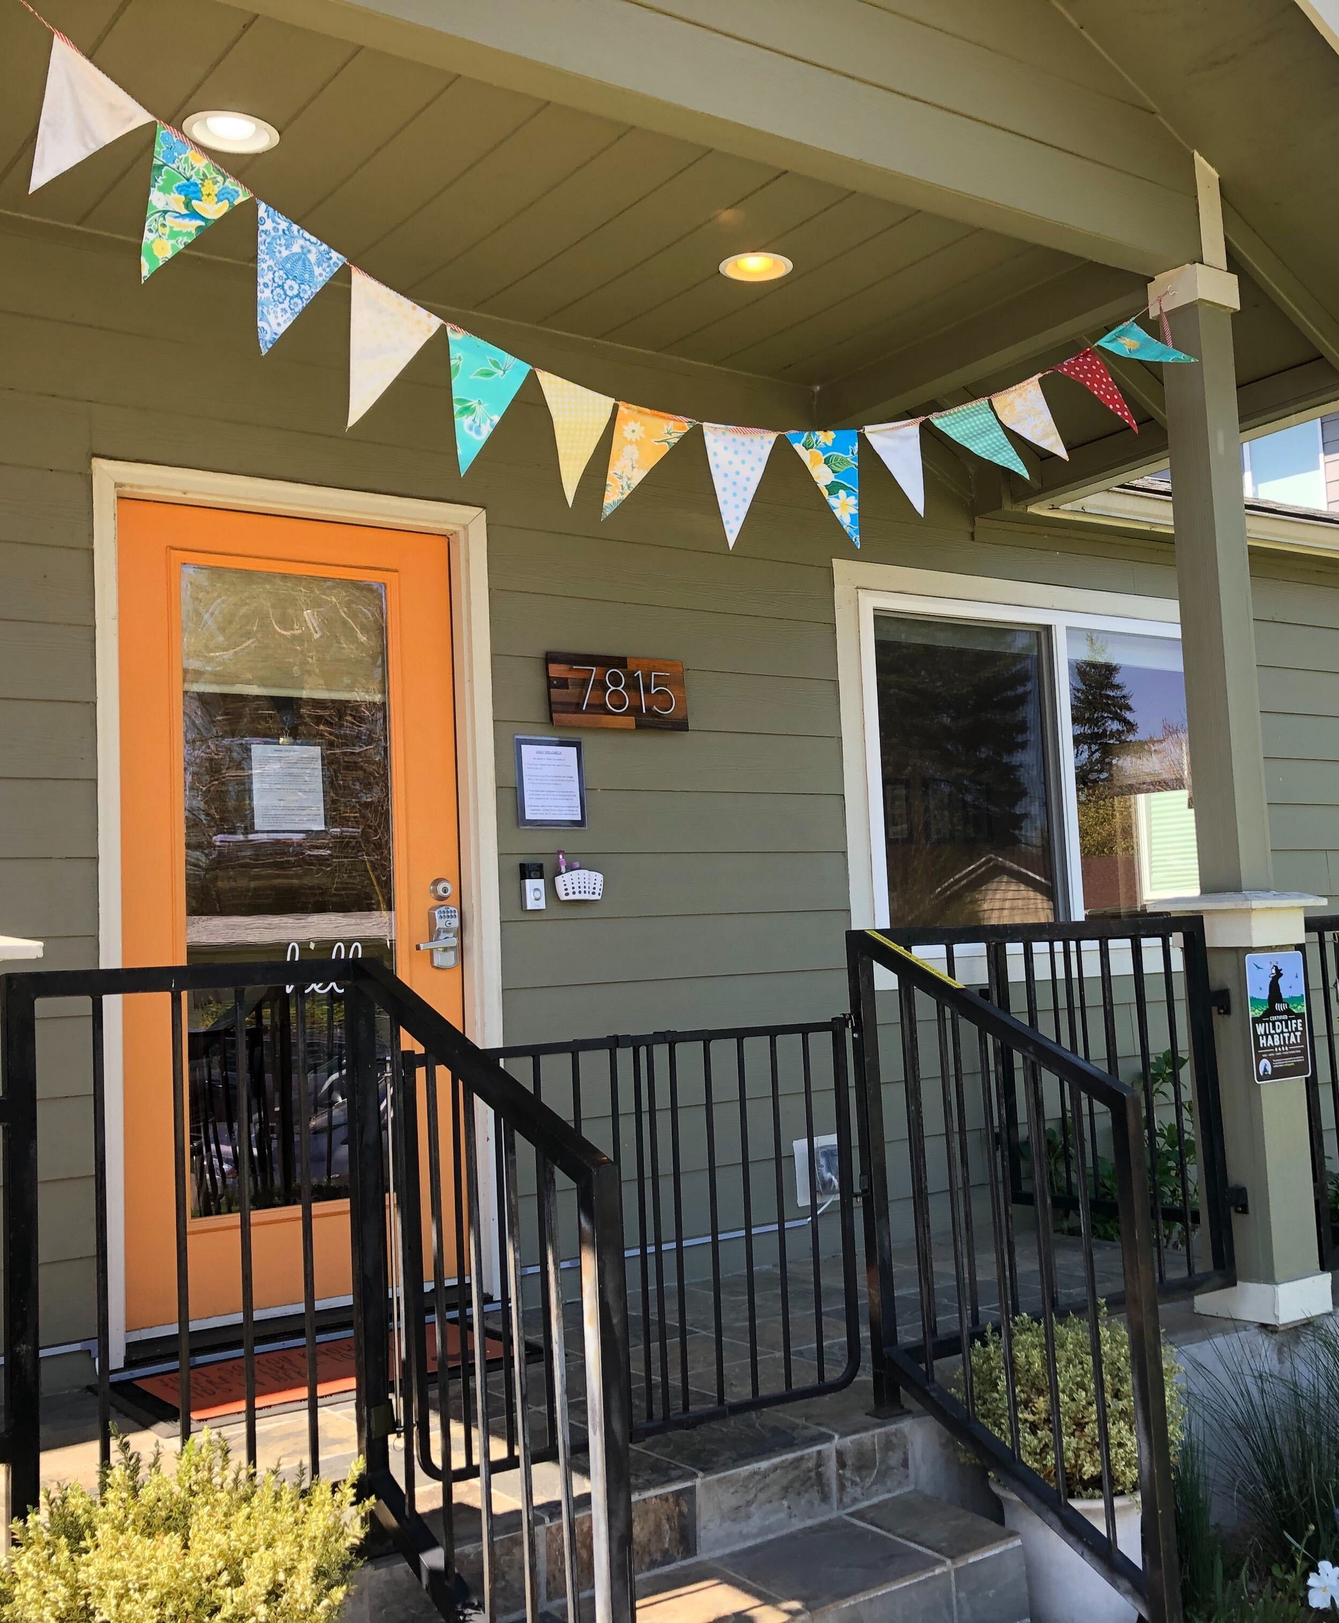
Universality
All the settings
family child care
centers
public schools
multiple languages
culturally inclusive or culturally specific but open to all
Notes:
For many families, choosing a preschool for their young children is a deeply personal decision. Preschool for All lets families select any setting, including culturally responsive ones, that fits their goals for their children. By including all settings, Preschool for All also supports current providers, who are predominantly women of color.

Slide 7
Fair Wages
Comparable to kindergarten teachers
Benefits of fair wages
economic, racial, gender justice
reduces turnover — people pushed out of field they trained for and love, harming quality
$74,700
Wage floor of 135% local minimum wage
$19.91/hr
$32,430
$12.46/hr
Proposed Fair Wage at implementation in 2022
Current Average Pay
Notes:
Child care workers are underpaid. Child care workers are also disproportionately women of color. Preschool for All addresses these intersecting economic, racial, and gender justice issues by guaranteeing all child care workers earn a living wage.
The measure establishes that lead teachers will be paid on par with kindergarten teachers and that assistant teachers will earn a minimum of 135% of the minimum wage.
Preschool for All also guarantees union neutrality, allowing preschool and child care workers to organize without interference from the county.

Slide 8
Funded by Tax on Highest Incomes
For example
After 2026, an individual with taxable income of $175,000 would pay 2.3% of $50,000, or $1150.
After 2026, a couple with taxable income of $500,000 would pay 2.3% of $125,000 ($2,875) plus 3.8% of $100,000 ($3,800), or a total of $6,675 — still well under the average annual cost of preschool in Oregon (2017) of $9,396.
Individual
1.5% on taxable income above $125,000/year (increasing to 2.3% in 2026)
3% on taxable income above $250,000/year (increasing to 3.8% in 2026)
Joint
1.5% on taxable income above $200,000/year (increasing to 2.3% in 2026)
3% on taxable income above $400,000/year (increasing to 3.8% in 2026)
Notes:
The progressive Preschool for All tax only impacts people who earn the highest incomes in Multnomah County. The tax begins at incomes of $125,000 after deductions for individuals, and it only affects the income above the thresholds shown on this slide.
This tax makes the program truly equitable: All families will be able to enroll their children, but only the people with the most money will pay. For many families affected by the tax, their annual taxes toward Preschool for All will be less than the average amount that Oregon families paid for a year of child care in 2017.
This is a better way to fully fund the program, and it removes the need for means testing. Means-tested programs often present significant barriers for people who qualify because they don’t have the time or capacity needed to fill out all the paperwork, collect all supporting documentation, and submit it all by required deadlines. By removing that barrier, Preschool for All will help more parents and caregivers access this critical resource.

Slide 9
How We Did It
Four phases Seven activities

Slide 10
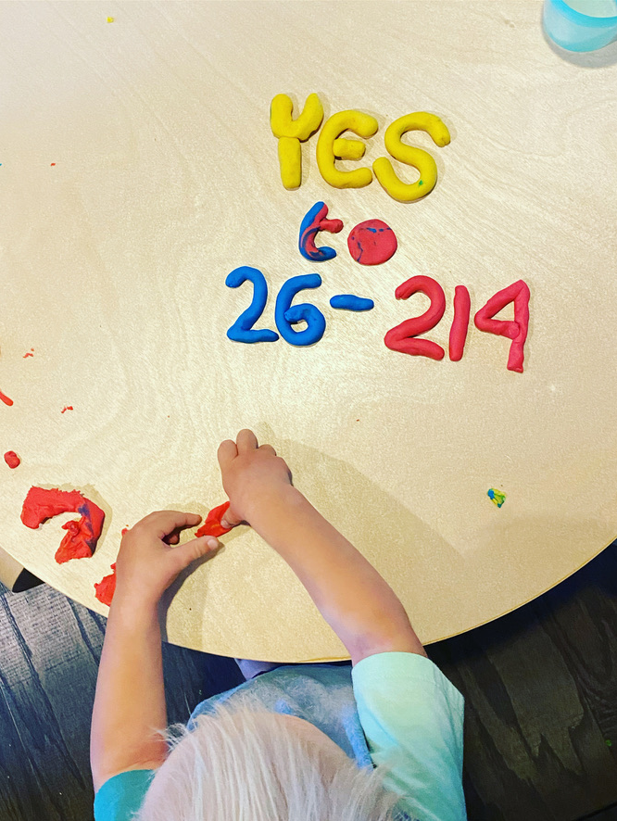
Four Phases of Universal Preschool NOW
Phase 1
Planning
Phase 2
Signature Gathering
Phase 3
Election Campaigning
Phase 4
Post-Election Messaging and What’s Next?
Notes:
We divided our campaign into four key phases: planning, signature gathering, election campaigning, and post-election.
At the end of each phase, we checked in with our volunteers and our coalition members to assess what was working, what went well, and what could be improved in the next phase.

Slide 11
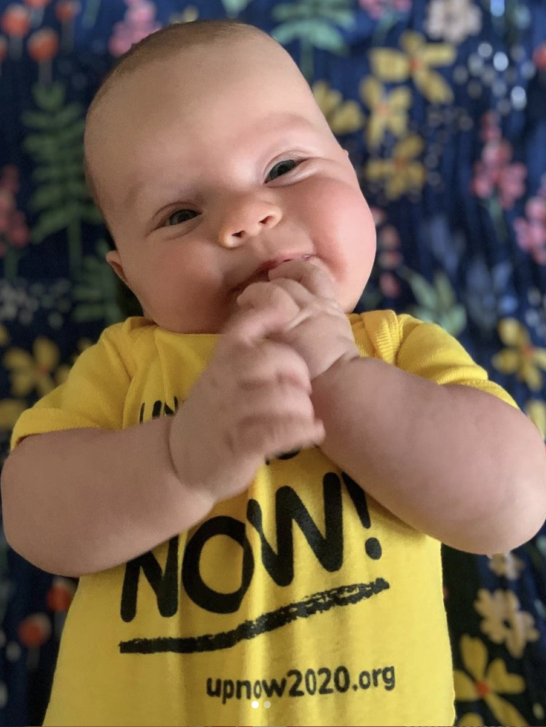
Seven Activities
Research
Coalition Building
Measure Writing
Fundraising
Communications
Field
Merger and Election
Notes:
All seven activities on this slide were crucial to the campaign. Many of them carried across the four phases of the campaign.
We formed teams around these seven activities, which streamlined the work and made it easy for volunteers to plug into the work they were most interested in.

Slide 12
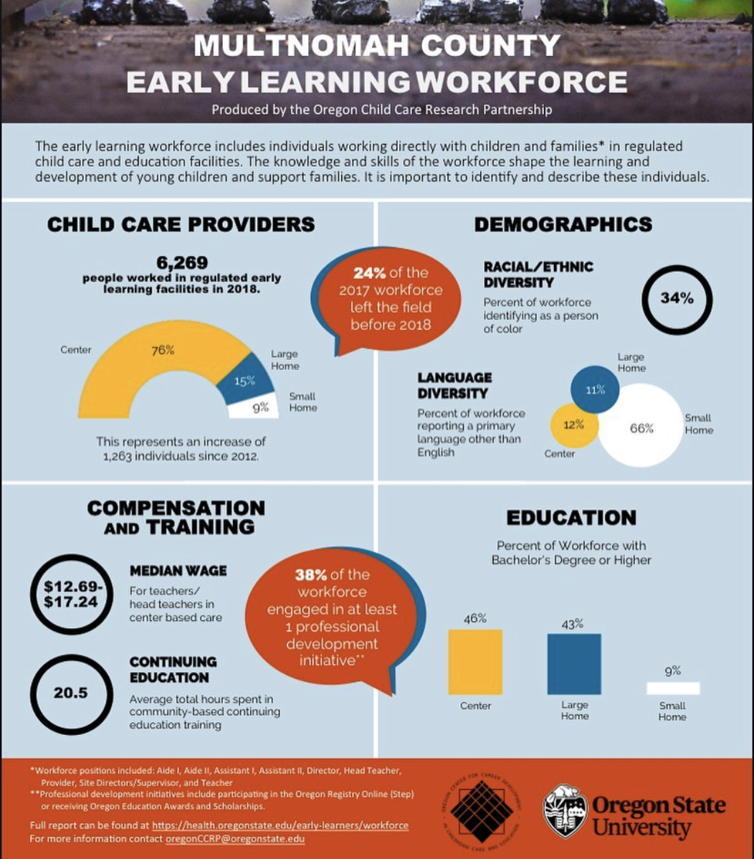
Research
Pick An Issue
Small enough to win
Big enough to make a real difference
Can inspire people
Study Existing Models
Universal preschool in other jurisdictions
Means-tested versus universal programs
Who’s working on it locally?
Design the Tax
How much revenue is required?
Income thresholds
Tax rates
Notes:
Solid research, especially in Phase 1, laid the foundation for a successful campaign. We started by researching a tax mechanism because our goal was to redistribute wealth in our community. Beginning with research and design of the tax mechanism was also useful for organizing. We were able to calculate exactly how much money we would raise and then ask different groups how they would spend that amount of money to support the community.
A team of volunteer researchers looked into the question of means-tested versus universal preschool programs. They looked at how universal preschool had worked — or had not worked — in other cities, counties, and jurisdictions. This research informed the text of our ballot measure. We also organized and saved the research so our communications team could share it later via social media, in op-eds, and more.
Questions to consider
Does it make sense for you to start by researching the tax mechanism, the focus issue, or both at the same time? Think about whether your goals connect to the tax or to a specific issue, and be realistic about your group’s capacity.
How can you involve people with all levels of experience in research? Some tasks could be easily completed by someone with no expertise in taxes or the focus issue (like looking up similar policies in other communities). Other tasks might require specific background knowledge (like producing detailed cost estimates for a new policy).
If you don't have all the expertise you need within your group, who can you reach out to for help? Who can help you make those connections?
How will you organize your research? Remember that you may want to refer back to articles or data points at later points in the campaign.
Will new polling be necessary to demonstrate the electoral viability of your idea, or are previous polls or voting results sufficient? If new polling is necessary, how can you obtain funding for it?

Slide 13
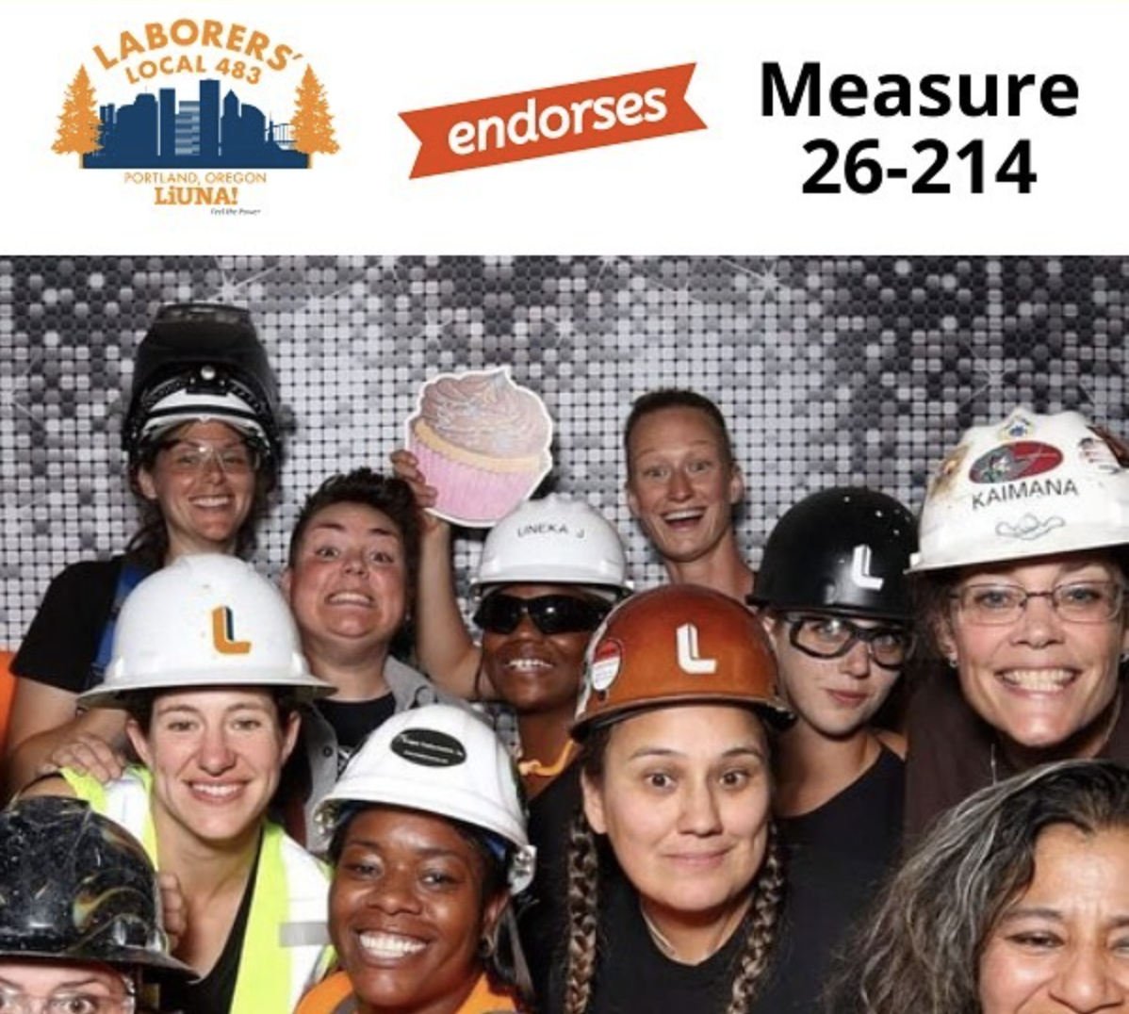
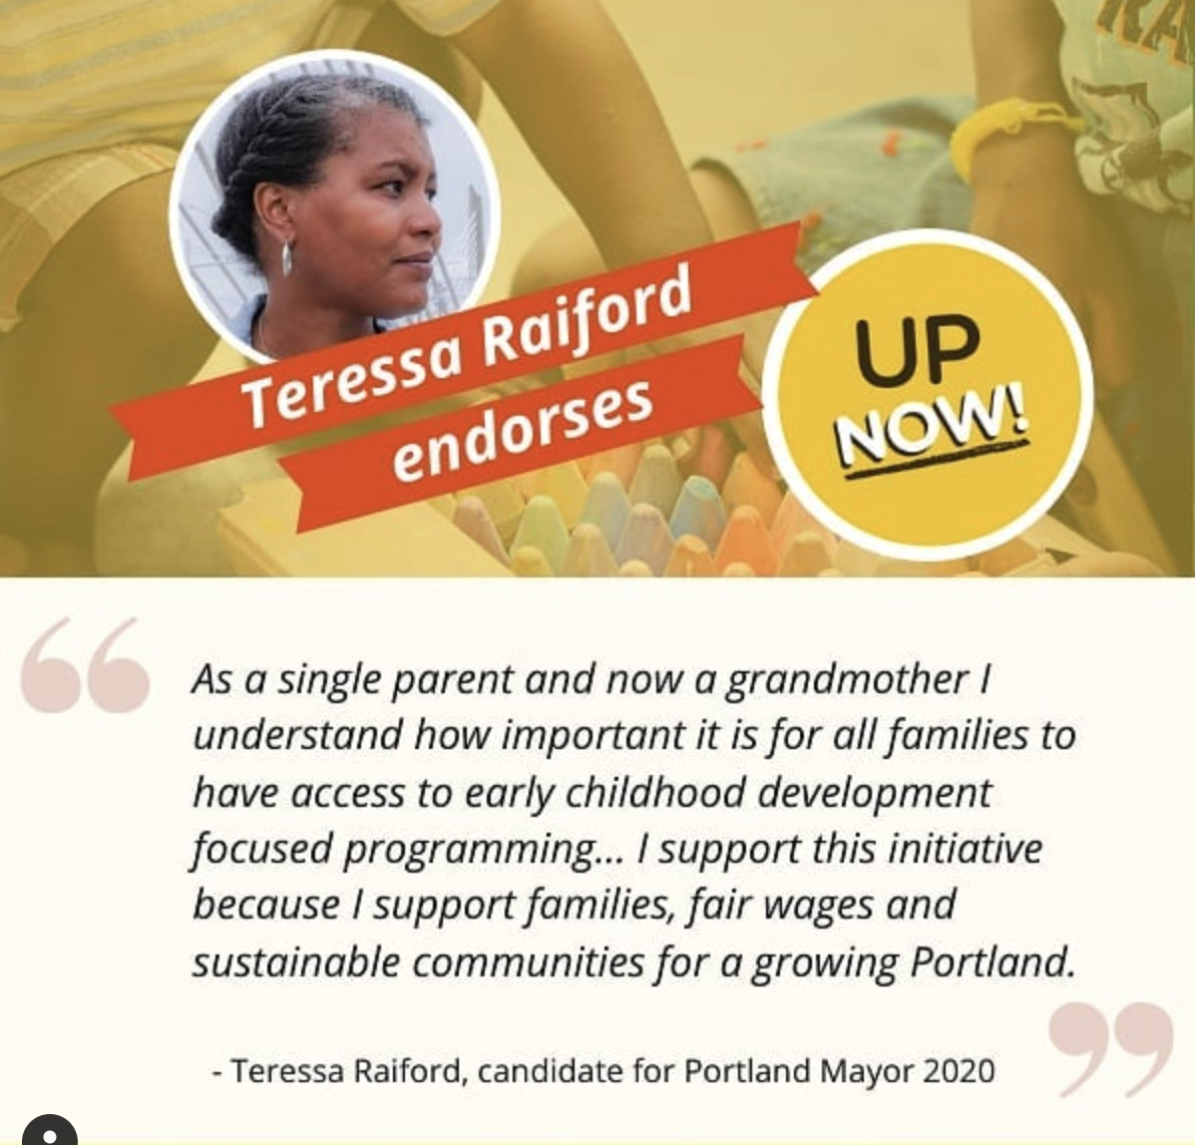
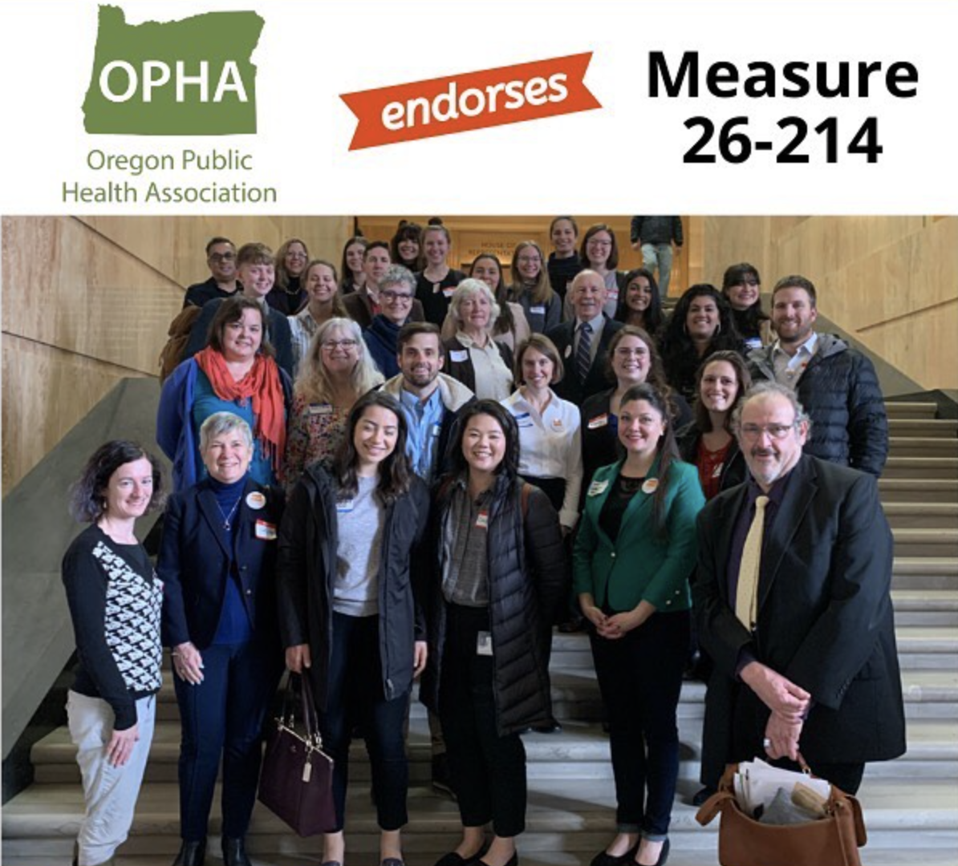
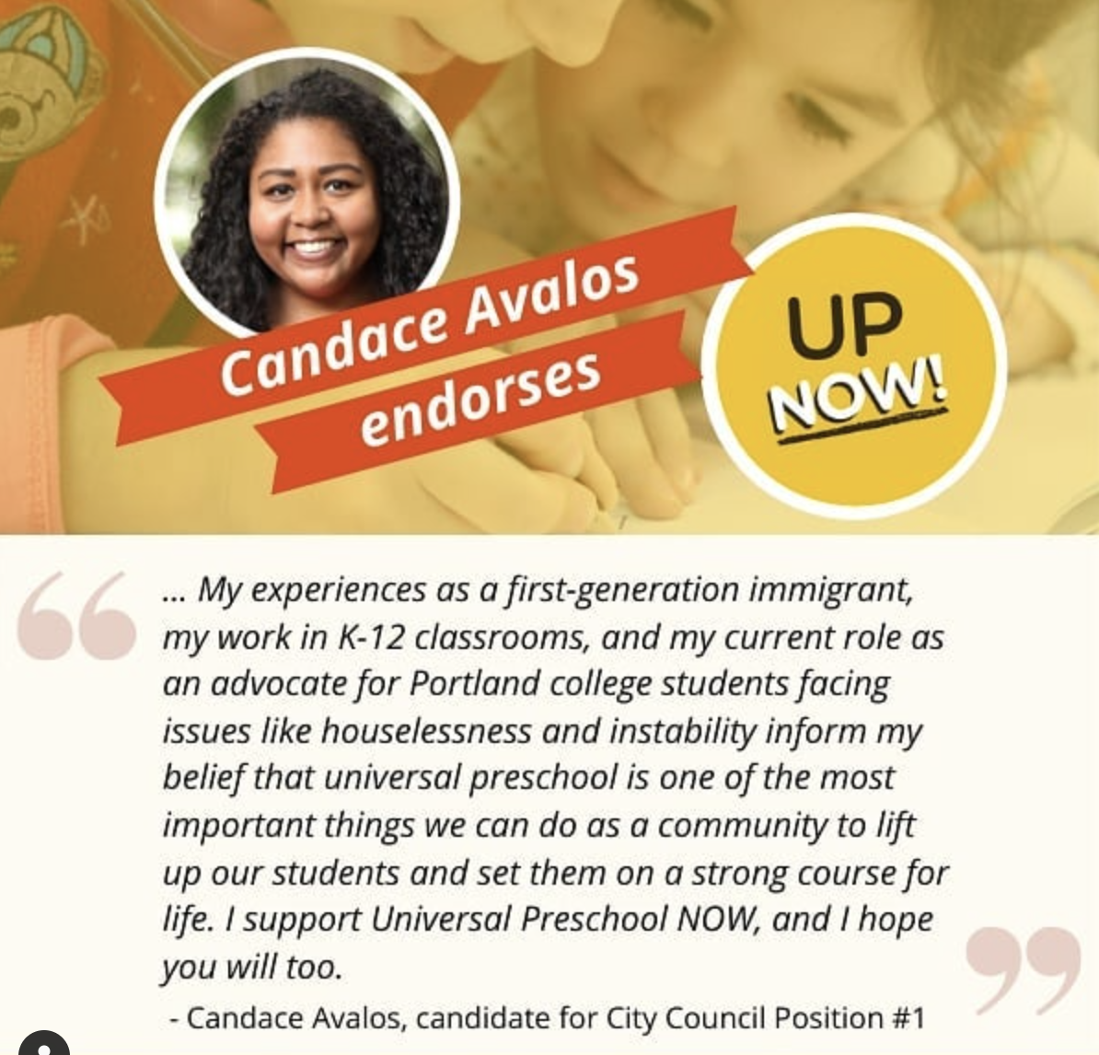
Coalition Building
Preschool and child care workers
Parents
Preschool providers
Membership organizations
Ad hoc cohorts: health care workers, small business owners, economists
Notes:
The UP NOW coalition includes more than 30 organizations, including labor unions, advocacy groups, neighborhood groups, and community-based and nonprofit organizations focused on reproductive, environmental, and economic justice. Coalition members were invited to be part of the core campaign team. The coalition also served as key decision-makers who voted on our campaign’s next steps at pivotal moments.
We also built our coalition by connecting with preschool and child care workers, parents, and preschool providers. Volunteers organized their own ad hoc cohorts who used their resources to spread word of the campaign and to share how, from their unique perspective, universal preschool would benefit the community. For example, small businesses organized a day to raise awareness and donate a portion of all proceeds to our PAC. Health care workers shared statements explaining the link between child care and health outcomes.
We pursued a coalition campaign because we felt that this would build capacity, encourage skill-sharing, and help us reach more people. We centered member-driven organizations because, as a completely volunteer-run campaign, we needed all the help we could get! We also wanted this campaign to be a true community win with broad grassroots support from the get-go. By contrast, grasstops organizations tend to be driven by influential boards of directors, which didn’t align with our organizing strategy.
Questions to consider
What are your larger organizing goals beyond this single campaign? How can you structure your coalition to achieve those goals?
Are there groups or communities that you want to engage in long-term organizing? How can you begin to build those relationships during this campaign?
Which communities are most impacted by the issue that your tax addresses? How will you prioritize their engagement and voice in decision-making?

Slide 14
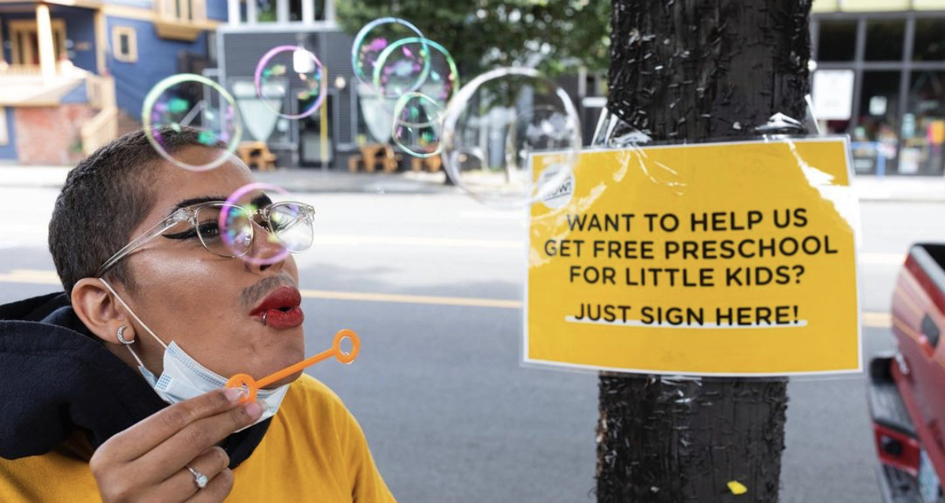
Measure Writing
Broad mandate or detailed framework?
Skills needed:
Paid election attorney
Volunteer attorneys
Notes:
We wrote our measure as a broad mandate without detailed implementation instructions. (We intended for the county, which would ultimately be responsible for implementation, to have agency over those details.) The core of the measure specified that all children would be eligible and that all workers would receive a fair wage that increases over time according to a specified schedule. Importantly, our measure also described a detailed tax mechanism to pay for the program.
We used funding from our political action committee (PAC) to hire an election attorney who helped us write the actual text of the ballot measure. This was an important investment because we faced legal challenges from the local business alliance at several points in the campaign. Having our measure legally vetted protected us from those challenges.
Alongside our attorney, a group of child care workers and our full coalition reviewed and gave feedback on each draft of the measure.
Questions to consider
How broadly or narrowly do you want to write your measure? Are there existing programs that you can borrow language from?
How will you meaningfully engage those impacted by the policy in the drafting of the measure text?
How will you identify an elections attorney who has the local court experience needed to defend your measure from potential legal challenges? Consider asking for a referral from local organizers behind prior successful campaigns..
Do any of your volunteers have enough legal background to start drafting your measure before handing it off to a specialized (and likely expensive) attorney?

Slide 15
Fundraising
Events (5k for Pre-K)
House parties
Coalition asks
Individual asks
Community-driven raffles
Notes:
Two key campaign volunteers were our treasurer and our fundraising lead. We established a political action committee (PAC) to organize financial contributions to the campaign. Federal Election Commission law requires that a PAC must have a designated treasurer before it can start accepting donations.
There are MANY rules about how you can and cannot spend funds from a PAC. (For example, we found out it’s illegal to give your phone-banking volunteers restaurant gift cards!) Get in touch with your Secretary of State for updated campaign finance rules.
Most of our contributions came from individual donors: The average donation was about $51. We raised this money through individual asks, our coalition partners, house parties, and events.
UP NOW volunteers took initiative and created different fundraising events with the support of our fundraising lead. Parent organizers planned a virtual 5K event that asked participants to make a suggested donation in exchange for a campaign 5K t-shirt. (They raised more than $13,000!)
Additionally, our volunteer team included a cohort of small businesses. These business owners helped raise money (and awareness) by donating a portion of their proceeds to our campaign on designated days or when people bought designated products.
Questions to consider
Who in your campaign has the capacity to serve as treasurer?
Before you spend money from your PAC, have you checked to make sure the expense is allowed?
How can you raise money?
What kind of team can you build to help raise money?
How can I involve the community in fundraising efforts?
What does your budget look like?
How will you raise money quickly for unexpected costs?
Resources
FEC - Registering a PAC

Slide 16
Communications
Earned media
Press
Op-eds
Letters to the editor
Owned media
Website
Social media
Emails to followers list and coalition list
Notes:
Frequent, original, and authentic communication with our supporters, coalition members, and community members was crucial to our campaign win. We tried to speak with real personality and emotion (rather than using a canned, corporate-sounding marketing voice) to reach and motivate regular people in the community.
During Phases 2 and 3, we sent weekly emails to our general supporter list as well as to our coalition members. In regular shifts, volunteers posted daily on all our social media platforms (Instagram, Facebook, and Twitter). We also updated our website as needed during each phase of the campaign.
Earned media — articles, op-eds, and letters to the editor — also boosted our campaign, especially during Phases 2 and 3. Our volunteer media liaison developed our press strategy , made sure our talking points were up to date, and helped our spokespeople prepare for interviews and media appearances. She handled interview scheduling and followed up with reporters before and after publication. This helped generate several pieces that built awareness and support. We shared these articles on social media to keep our followers in the loop.
Questions to consider
What are your long-term and immediate communications goals? Do you have a specific call to action (signing up to volunteer, signing a petition, going to an event, donating money)? Are you giving people a way to get involved, or just talking at them?
Which roles do you need on your communications team? How will you share the work and make it visible to everyone? How will your team communicate with one another?
Do you have a volunteer who has access to a media list and experience with media relations? Ideally this person will also help prepare talking points for other volunteers who are willing and able to serve as campaign spokespeople.

Slide 17
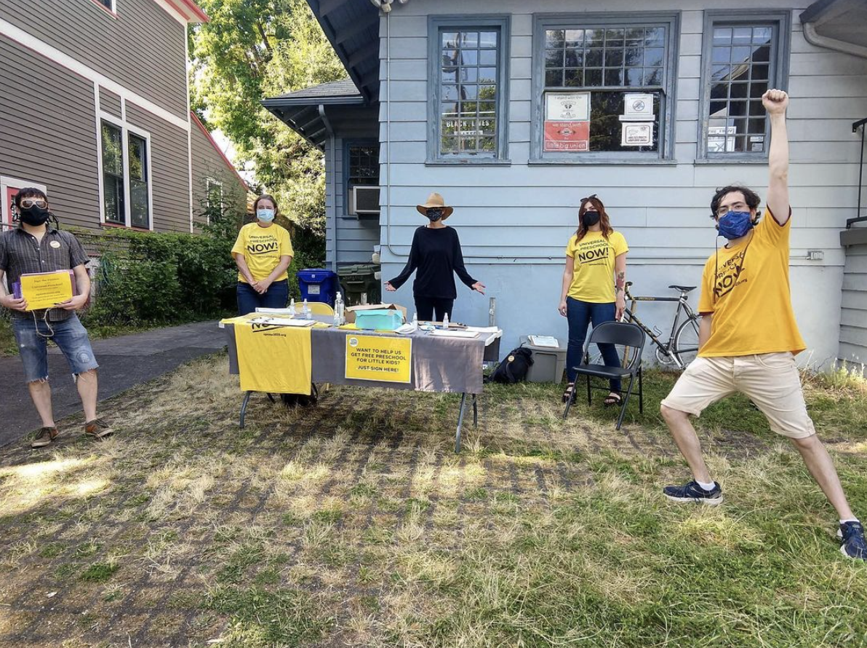
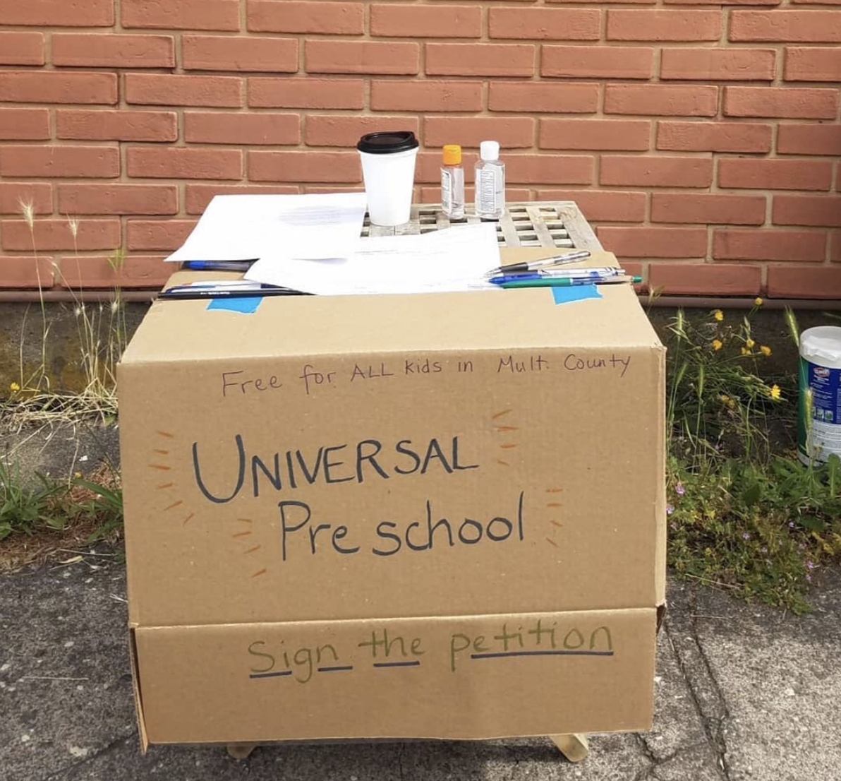
Field
Early canvassing for list-building
Signature gathering: over 600 volunteers, drop-boxes on porches, data entry
Virtual field: phone banking, text banking — one paid staff position
Speaking at rallies
Physical Get Out the Vote: lawn signs, stickers, flyers on telephone poles, banners, march
Notes:
Field is the heart of grassroots organizing — this was very difficult during the COVID-19 pandemic. Fortunately, we had started community outreach more than a year before the election by tabling and canvassing. We went to farmers markets, music festivals, and community events like bike rides to hand out flyers with the basic points of the program. We also asked people to sign up for our email list and to sign up as volunteers.
In Phase 2, we needed 23,000 signatures to qualify for the ballot. By the time we were approved to begin collecting signatures, we had only five weeks until the deadline. At that point, we were a few months into lockdown due to the pandemic.
Because we laid a careful foundation of community involvement and coalition-building, we had more than 600 volunteers collect signatures. They did this safely and creatively in a variety of settings. Small businesses advertised the measure and hosted signing stations. People set up socially distanced signing tables in their driveways. Teachers gathered signatures at parks and playgrounds. During this time, large numbers of people were also turning out for protests and rallies in the wake of the police murder of George Floyd. We asked event organizers for permission to gather signatures nearby in such a way that would not distract or detract from the event or its message, and made sure to collect signatures only when it was safe for folks to carry personal information.
Through our website, we also set up an option for people to print signature sheets from home and mail them back to us. (People without printers could also request a printed sheet be mailed to them — we sent these out with a pre-stamped return envelope.) When we neared our deadline, we stopped advertising this option because we needed to have all signatures on hand and didn’t want to risk getting any late in the mail.
In the end, we collected more than 32,000 signatures — nearly 10,000 more than we needed to qualify for the ballot!
In Phase 3, we used our PAC funds to hire a field coordinator. We accessed a voter activation network (VAN) through a coalition partner which allowed us to phone-bank and text-bank voters. We also engaged in creative, volunteer-driven “get out the vote” events, including literature drops, sign-waving, and even a Halloween-themed “Austerity Is Scary” rally and costume parade.
Questions to consider
Creating a field plan is the first step! Once you know how many volunteers it will take to accomplish your goal, start training people. As soon as you are approved to begin gathering signatures, you want to have a fully trained group ready to go!
Do you have the funds to pay for a field coordinator, even if only part time?
How can you leverage resources and connect with other organizations or campaigns to maximize your reach? (Consider: gaining VAN access, asking coalition partners to phone bank, or partnering with other campaigns to do collaborative lit drops.)

Slide 18
Notes:
Even with the best-laid-plans, you’ll need to stay flexible!

Slide 19
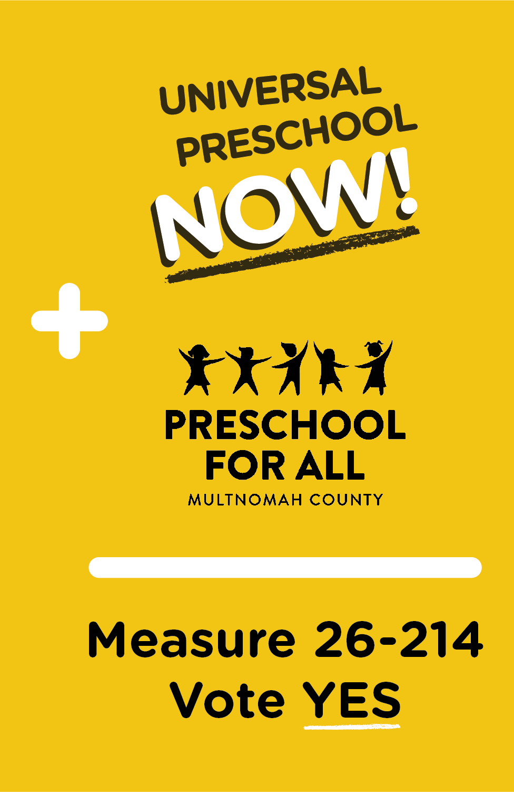
Merger and Election
Merger with rival campaign contingent on qualifying for the ballot
Merger eliminated scenario of two measures on the ballot — both would fail
Combined field operation, coordinated but independent campaigns to leverage existing support
End result: 64% yes
Notes:
The UP NOW merger was a unique situation, and it’s unlikely your campaign will go through this exact scenario. However, it highlights the importance of understanding your local political landscape. Research previous (and ongoing) efforts to address the issue your measure will focus on so you can learn what has worked, what hasn’t worked, and who has been involved.
As UP NOW was taking shape, other community members were engaged in a separate effort to expand access to early learning in our county. As soon as we learned this, we kept in close communication with the other group. Both groups hoped to create a merged vision and campaign ahead of the election.
After our measure qualified for the ballot, the other group had the choice to run a separate campaign against UP NOW or to merge and adopt our core proposal. We ultimately negotiated a proposal that maintained our priorities to make the program universal, pay all workers a living wage, and tax the wealthy to pay for it. By merging, we developed a broad and powerful coalition to support the measure in the community. We also avoided the risk of splitting the vote and confusing voters by putting two preschool programs on the ballot.
The result of this merger was an election victory with 64 percent of voters saying YES!

Slide 20
What We Learned
Choose electorate
Start early
Get advice
Ignore some advice
Build a movement
Notes:
Grassroots campaigns need to be simple, popular, and have a long “runway” before the election to get the word out.

Slide 21
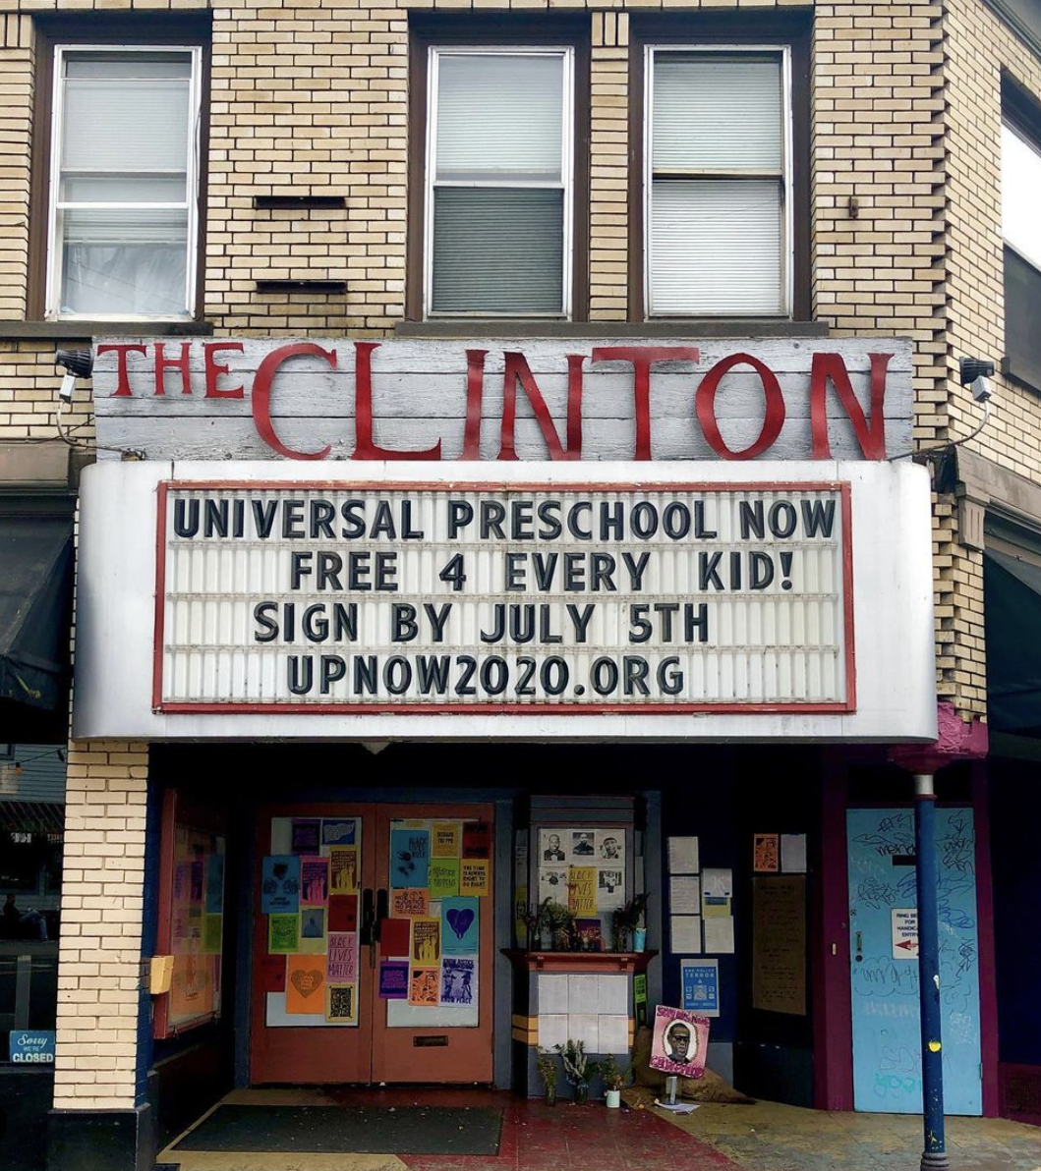
Choose Electorate
One you can influence
One inclined to support you
One that houses the type of program you want
UP NOW chose county, not city, three-county metro area, or state
Notes:
Think about what you’re trying to accomplish: Which municipal entity is the right one to target? Is it your city? Your county? Your state? Each one will have different requirements and very different win numbers (the number of votes you need to win). Assess your capacity and understand each potential electorate to find the right fit.

Slide 22
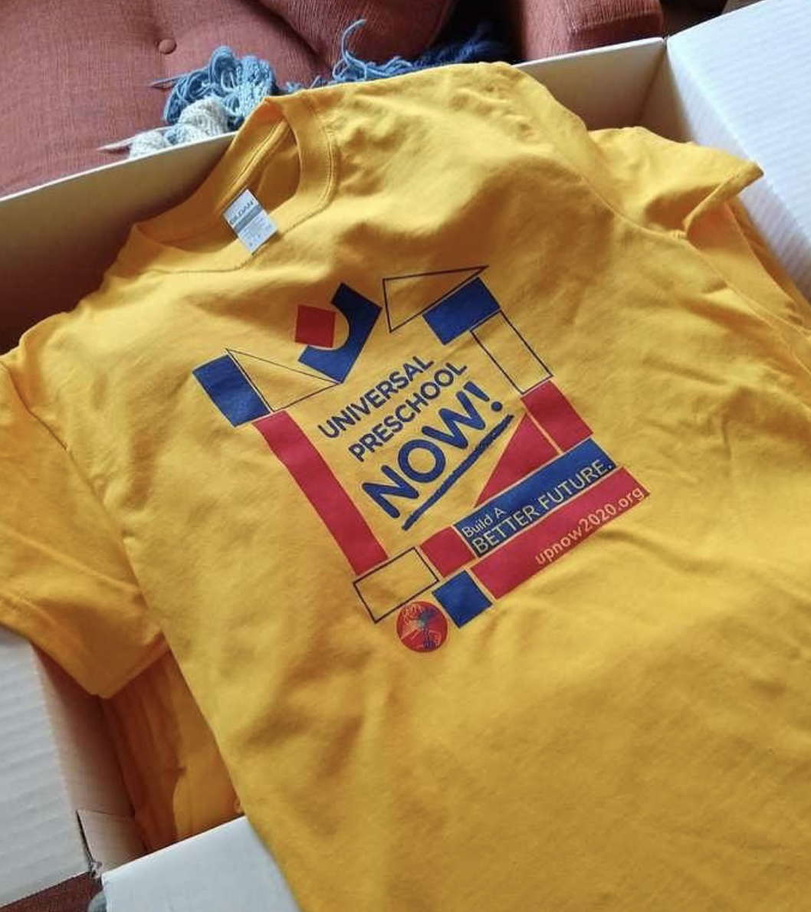
Start early
Why?
generate momentum
collect valuable feedback
practice presentations
How?
Scope landscape
at your target level (for us, county)
at other levels (like state)
Look for
opposition
friendly opposition/rivals
non-electoral initiatives in the same policy arena
Notes:
Most people don’t pay attention to elections until a couple months before Election Day — for a campaign, you’ll need to start much earlier. Work backwards and consider all the steps that go into a campaign, the potential roadblocks you might encounter, and how much time you’ll need. How long will it take to fundraise? To build a base? To draft your measure language? Should you build in extra time in case of legal challenges?
You also may want to consider which election you want to target: Would your campaign do better with the electorate in a high- or a low-turnout election?

Slide 23
Get advice
Universal Preschool NOW got valuable advice from large coalitions and experienced organizers
Portland Metro Peoples’ Coalition
Our Oregon
PDX Forward
...even a political staff member of a non-endorsing union
Notes:
Traditional campaigns rely extensively on polling, but this can be expensive for a grassroots effort. Ask friendly, knowledgeable people to give you informal advice and share what they know about the electoral landscape. These people may also be able to share polling that can help point you in the right direction.
See if groups who have run campaigns in your area before would be open to sharing advice. They may have valuable insight on where to collect signatures, who you should connect with, and how to engage local voters. This is also a good way to build your network and find potential campaign volunteers or supporters.

Slide 24
Ignore some advice
Some said to choose a smaller, mid-term election to avoid competing demands, voter fatigue, and difficulty messaging through the noise
But, a crowded ballot can distract opposition that has bigger fish to fry
You can’t do everything people will suggest
In the end, you have to decide what’s right for your campaign — that’s the work!
Notes:
You don't need to take every piece of advice that is offered to you. You also may not want to take all advice you’re offered at face value — there could be many reasons that people want to impede your efforts.
Form a core, trusted group within your campaign so that you can have open discussions before making decisions. It will be helpful to hear their different perspectives when you receive conflicting advice or when someone outside the campaign tells you that an idea is not good or won’t work.
Polls are another piece of “advice” to take with a grain of salt. Polls are commissioned by someone with a specific agenda in mind. If that person isn’t you, the polling questions may not actually give you the information that YOU need.

Slide 25
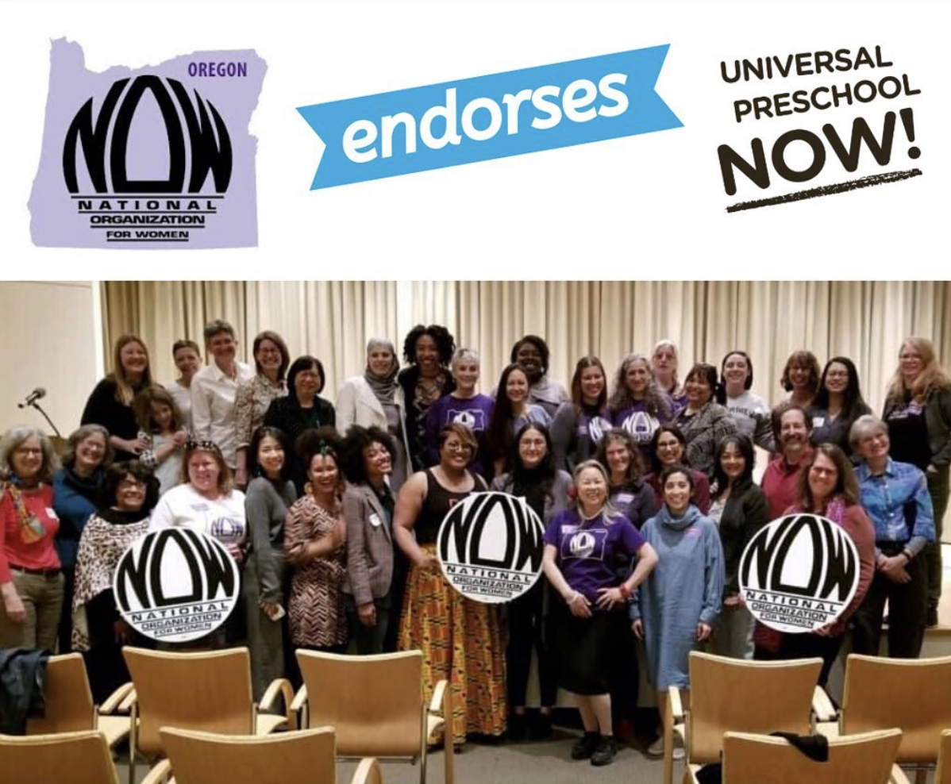
Build a Movement Through Coalition
Who?
Unions
Political parties
Membership organizations
Ad hoc cohorts
Parents
Child care workers
Small businesspeople
Notes:
List everyone who would immediately benefit if you win your campaign. Reach out to those people first! After that, consider all the secondary or tangential groups that would benefit — this is the second circle of groups and communities that you should connect with. For UP NOW, child care workers and parents were two groups that would be immediately affected by our win — these were two core groups in our campaign coalition and volunteer team. Some secondary groups included health care workers, small businesses, and K-12 teachers.
Be mindful that a grassroots campaign requires A LOT of volunteer power. This should inform your coalition outreach. Spend time reaching out to and building relationships with membership-led organizations like unions and civic groups. Nonprofit and advocacy organizations may also be relevant to your effort even when they are not membership-based: Assess what reach they have and whether they could contribute as a validator rather than as a source of volunteers.

Slide 26
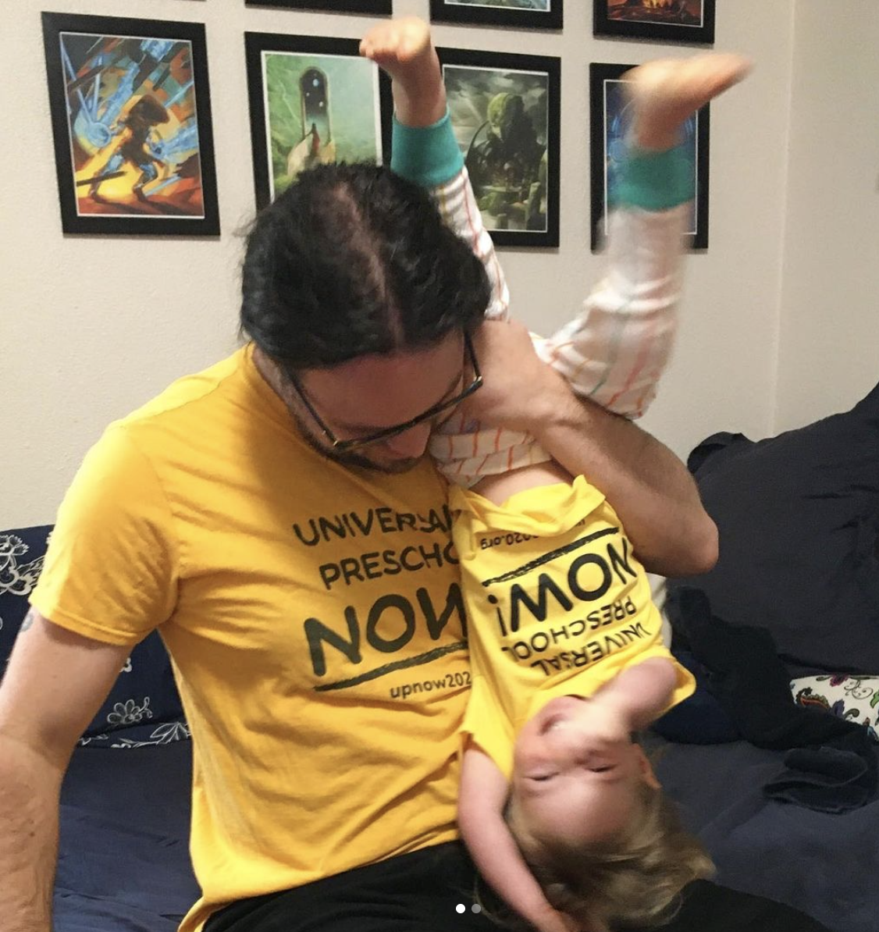
Build a Movement Through Coalition
Why?
Mobilize more people than we could reach directly
Enabled signature drive to qualify for the ballot, despite pandemic and opposition of business lobby
Pressured county commissioners to pay attention
Forced rival coalition with more modest measure to adopt the key elements of our platform
Notes:
Coalitions can represent the diversity within a community better than any single organization. That diversity of perspectives helps build strong policy that reflects community culture and values. This type of policy will stand a better chance of winning and, in the long run, of succeeding.
Coalition organizations can lift up different components of the campaign that may speak to different audiences. The UP NOW coalition had members in many fields, so our members could highlight specifically how our campaign would impact them as teachers, as health care workers, as parents, as feminists, as small business owners. A well-rounded coalition is a huge asset in the “get out the vote” phase: If polling shows that support is low among a specific demographic, one of your many coalition members might be the right partner to develop messaging to reach that voter group.
Resource: The Multnomah County November 2020 voter’s guide: our endorsements start on page 56 and end on page 67. https://multco.us/file/92543/download

Slide 27
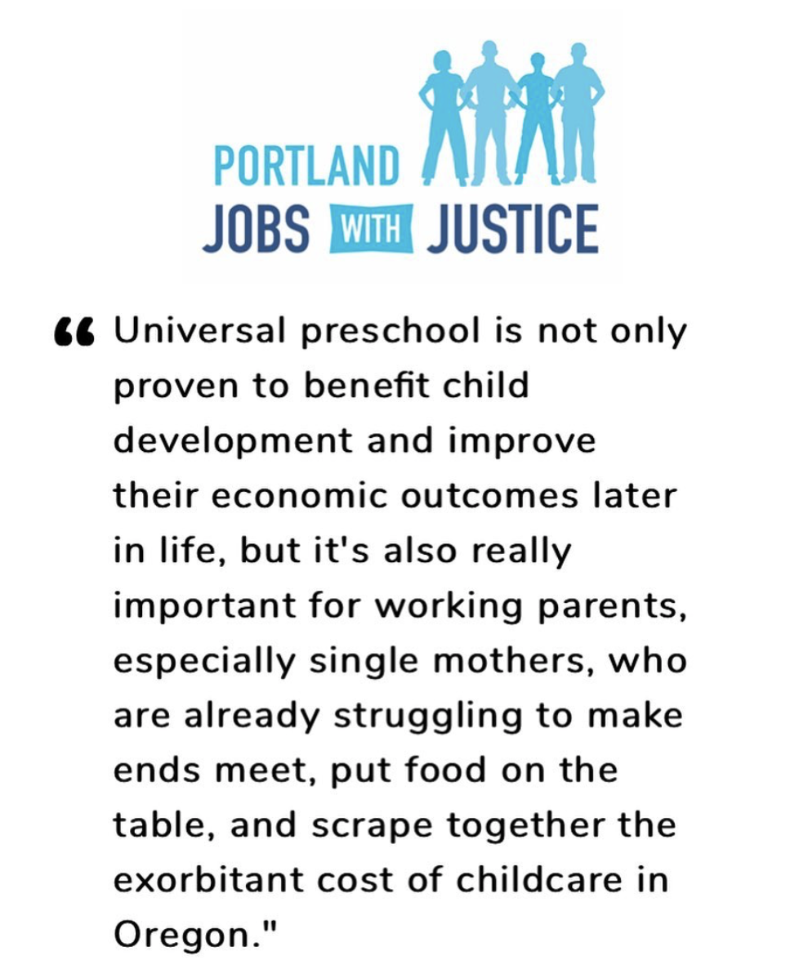
Build a Movement Through Coalition
How?
Three chief petitioners represented key groups
Portland Association of Teachers
Portland Jobs with Justice
Oregon NOW
Identify or develop personal connections with potential allies
Build relationships by supporting other groups’ initiatives
Talk to any group you can, even if you don’t expect support
you may be surprised
identify people ready to become dedicated volunteers
Notes:
Early outreach is key! From the start, your coalition members should have an authentic role in decision-making. They should participate in developing both the policy and the campaign. This will ensure that each organization feels fully invested in making the campaign succeed. Present a clear picture of how coalition members can participate and what they will be expected to do — especially for membership organizations who will likely need to vote to join you. Make it a priority from the beginning to make clear asks and develop lines of communication that you will carry through the campaign.
At the same time, organizations often need something concrete from you to endorse. We drafted “points of unity” that detailed the core planks of our program that we used to build the coalition before we had final legal language drafted.

Slide 28
What’s Next?
Do you want to start a campaign for universal preschool in your community? Or join us for what we tackle next? Get in touch!
upnowmultco@gmail.com
Notes:
Are you ready to launch a campaign of your own? We here at UP NOW/Portland Democratic Socialists of America are more than happy to talk about your plans, answer any questions that we can, and help with more materials!
Reach us at upnowmultco@gmail.com, upnow2020.org, or on our social media (Instagram, Facebook, and Twitter)!

